Slide 1

C Practice 3
Notes:
Click to add notes

Slide 2
C Programming Practice Question 1
Print a text string “this is a test” one char at a time
Hint:
1. sizeOf()
2. myStr[i]
Notes:
Lesson descriptions should be brief.

Slide 3
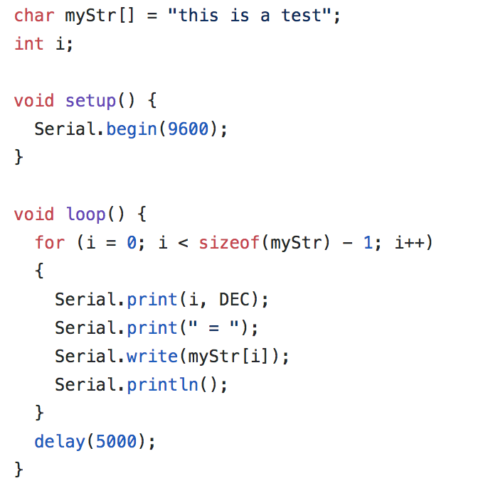
Answer
Notes:
Lesson descriptions should be brief.

Slide 4
C Programming Practice Question 2
Use do-while statement to generate 10 random numbers every one second. The random numbers must be less than 100.
Hint:
1. random()
2. while (condition)
Notes:
Lesson descriptions should be brief.

Slide 5
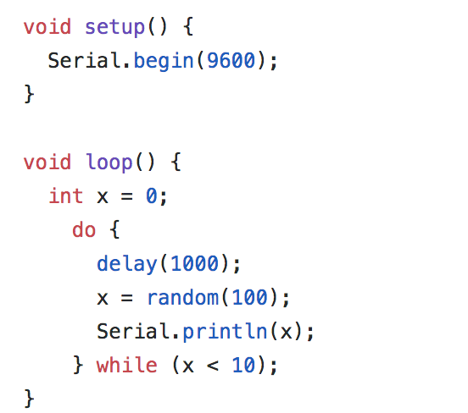
Answer
Notes:
Lesson descriptions should be brief.

